Slide 1

YEAR 3
READING WORKSHOP
2025-2026

Slide 2
Members of staff
- Teachers:
- Mrs Vataj – 3A
- Mrs Powell-Green– 3B

Slide 3
Welcome
Aim:
To get children to develop a ‘LOVE FOR READING’
To use ‘TALK’ as a tool to enhance children’s interest in reading while developing their comprehension skills

Slide 4
Reading for Pleasure – Why It Matters
1. Builds Strong Literacy Skills
Children who read for enjoyment naturally develop better vocabulary, spelling, grammar, and comprehension skills.
It helps them process language patterns and ideas more easily
2. Boosts Academic Achievement
Enjoyment of reading has been linked to higher performance across subjects — not just English.
Children who love reading often perform better in maths and science too, because strong comprehension skills underpin all learning.
Yearly overview – continued
Yearly overview – continued

Slide 5
Reading for Pleasure – Why It Matters
3. Fosters Imagination and Creativity
Stories help children visualise new worlds, think beyond their environment, and develop creative problem-solving skills. It gives them the freedom to explore possibilities and express themselves in different ways.
4. Enhances Emotional Intelligence
Reading encourages empathy. When children immerse themselves in characters’ lives and challenges, they learn to understand feelings, perspectives, and experiences different from their own.

Slide 6
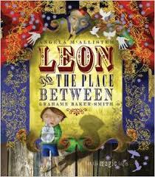
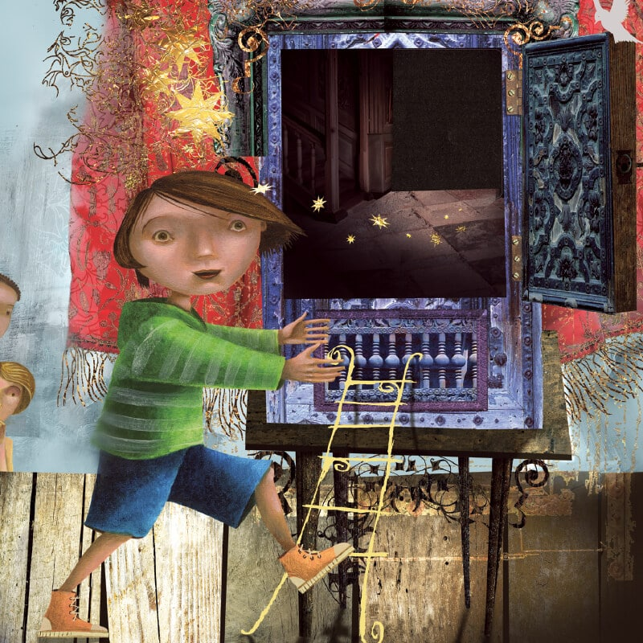
Reading for Pleasure – Why It Matters
Fosters Imagination and Creativity and Enhances Emotional Intelligence
Here is the cover illustration and an inner page of a story.
Think as a child.
. What can you see?
. Who could the boy be?
. Where is he?
. Why is he there?
. How is he feeling?
. Where does this place remind you of?
. Would you like to be the child in the picture? Why?

Slide 7

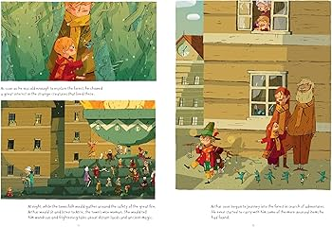
Reading for Pleasure – Why It Matters
Fosters Imagination and Creativity and Enhances Emotional Intelligence

Slide 8
Reading for Pleasure – Why It Matters
5. Supports Mental Wellbeing
Books can be a source of comfort, escapism, and joy. They help children manage stress, build resilience, and find positive coping mechanisms. Quiet reading time can be calming and grounding.
6. Strengthens Concentration and Focus
Regular reading helps children develop longer attention spans, patience, and the ability to sit with tasks — essential skills for school and beyond.

Slide 9
Reading for Pleasure – Why It Matters
7. Encourages Independence and Self-Identity
Children who choose their own books learn to follow their interests, express preferences, and build confidence in their own judgement. Stories can also help them explore identity and personal values.
8. Creates Lifelong Learners
A child who discovers pleasure in reading builds a habit that can enrich their whole life — opening doors to knowledge, hobbies, confidence, and personal growth.

Slide 10
The Importance of ‘TALK’
Using talk to develop children’s understanding in reading is about:
helping them think aloud
make meaning
connect ideas before, during, and after reading
and turning reading from simply decoding words into truly comprehending them

Slide 11
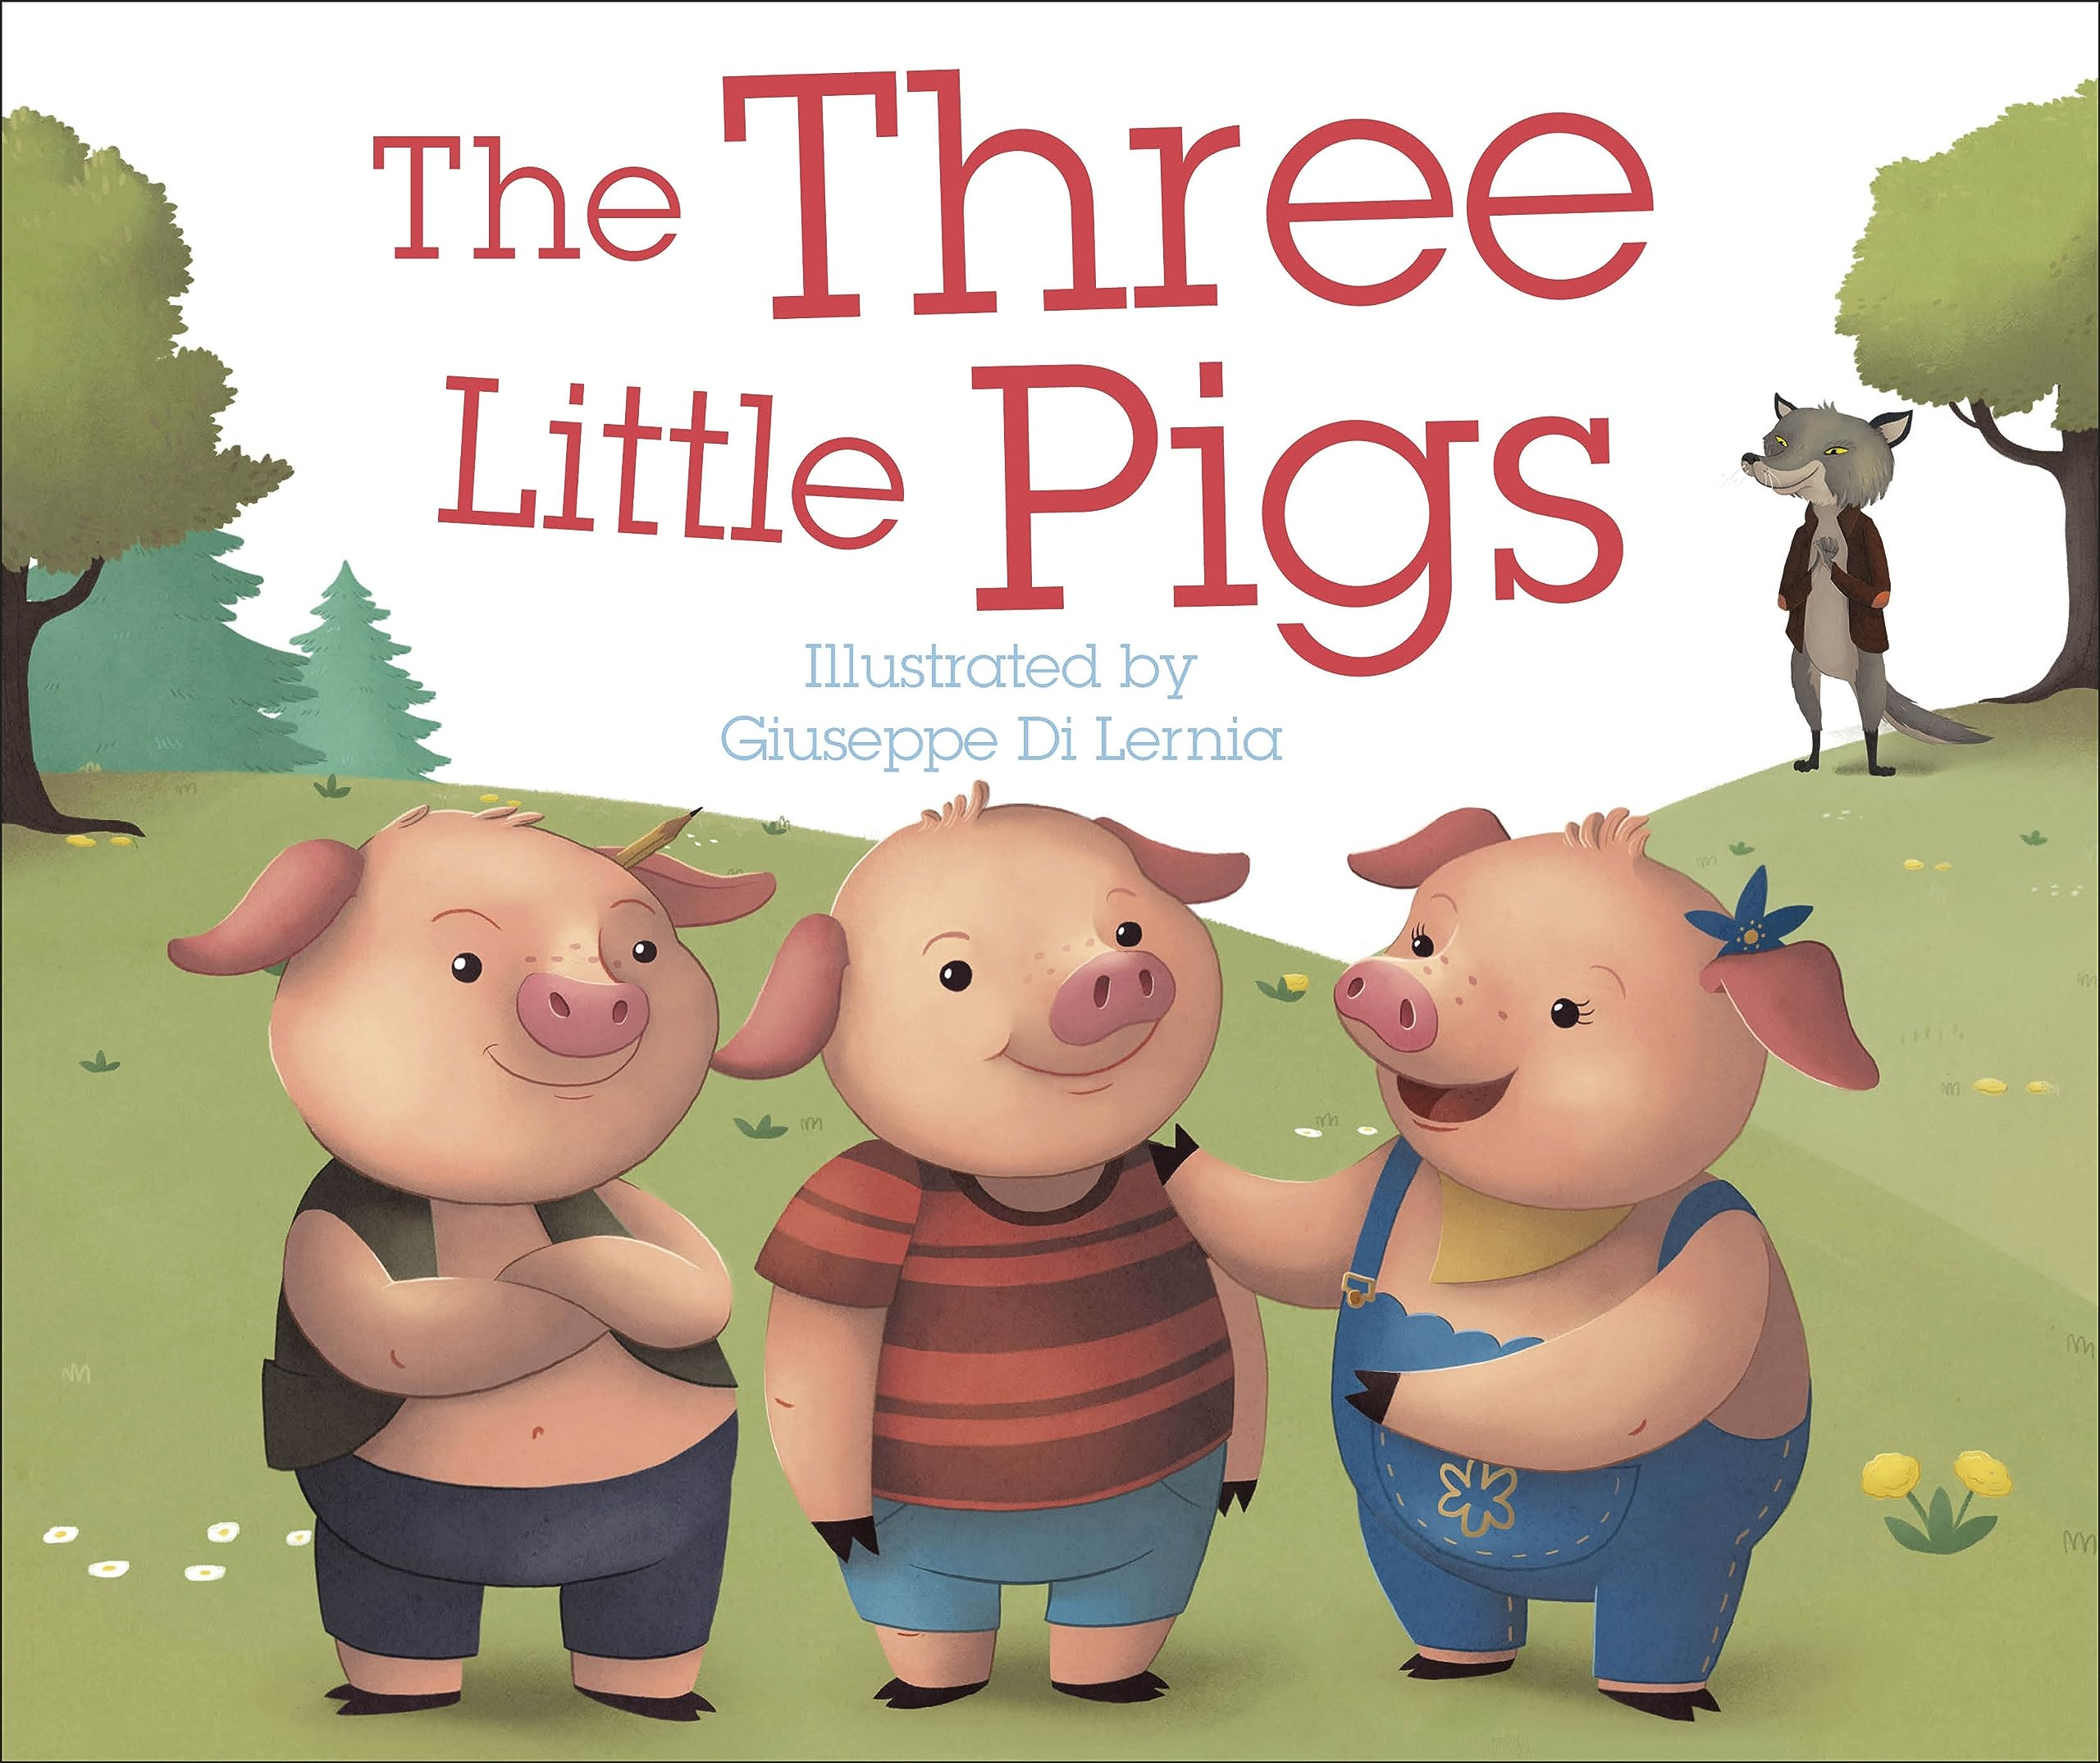
How to engage children
Effective learning begins with prior knowledge.
What were some of your favourite books as a child? Why?
Which type of stories do you find your child reading over and over again? Why do you think this is so?
Most children tend to remember traditional tales.
They remember the sounds, the voices of the characters, how the characters looked and dressed.
Eg. I will huff and puff and blow the house down! (Extract from ‘The Three Little Pigs’)

Slide 12
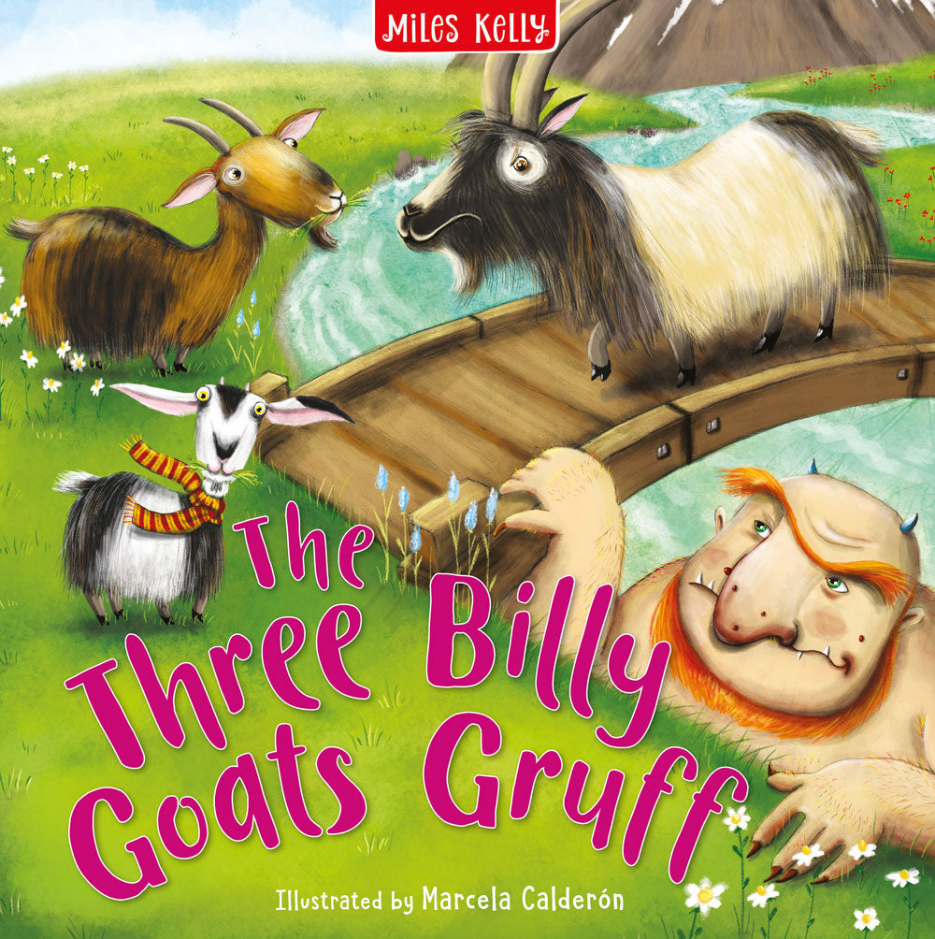
How to engage children
Effective learning begins with prior knowledge.
Prior knowledge can be in different ways.
Examples:
- Provide the language (Naming the
things they see in
Familiar setting (probably the child read a book with a similar topic, or the child visited a similar place
Other books by the same author
etc.

Slide 13
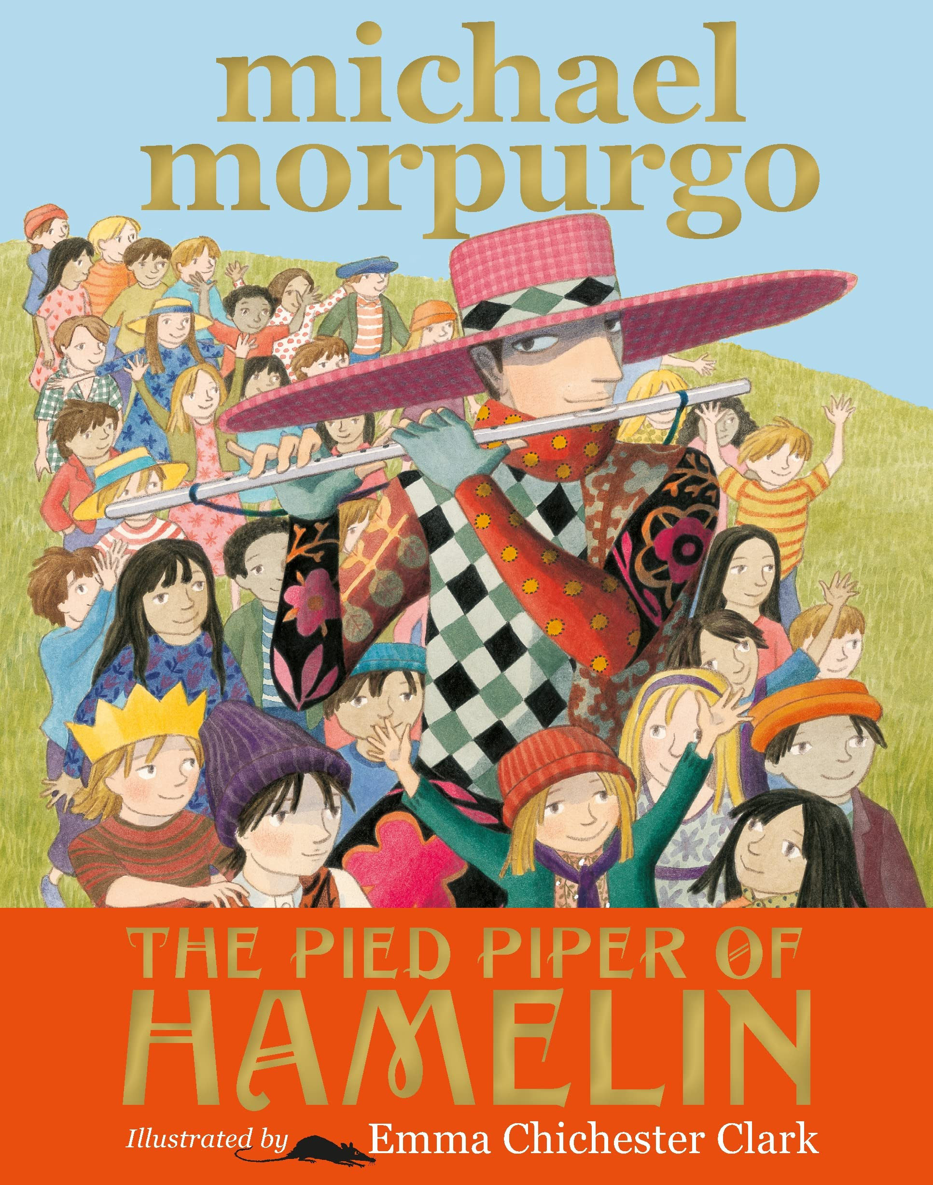
How to engage children
Look at this cover illustration.
How could you use talk to get your child hooked in this book?
What questions could you ask?

Slide 14
How to engage children
Example prompts:
Before reading – spark curiosity:
  KS1: “Who do you think this story is about?”
  KS2: “What clues can you see about the plot?”
During reading – deepen understanding:
  KS1: “Why do you think they did that?”
  KS2: “What might this tell us about the character?”
After reading – reflect and connect:
  KS1: “What surprised you?”
  KS2: “What message do you think the author wanted us to learn?”

Slide 15
How can you support a ‘Love of Reading’?
Supporting a Love of Reading
To nurture a child’s reading habit:
This means creating an environment and routine that encourages them to enjoy reading, explore books willingly, and develop a lifelong love for learning through stories and information.
It's less about forcing reading, and more about building curiosity, joy, and confidence in reading.

Slide 16
How can you support a ‘Love of Reading’?
Supporting a Love of Reading
To nurture a child’s reading habit:
Encourage interest rather than pressure results.
Eg. Show interest in their home readers (Draw child’s attention to the cover illustration and start talking about what captivates you. Start thinking aloud about what the book could be about, …)
Model reading so they see it as a normal, enjoyable activity.
(Get in role as characters: change voice and expressions, use punctuations effectively to get meaning across, …)

Slide 17
How can you support a ‘Love of Reading’?
To nurture a child’s reading habit:
Support them at their pace, without making reading feel like a test.
- If your child isn’t a fluent reader, if possible, read the text aloud to the child at first
- It is OK to read a page/book/story multiple times.
Help them associate reading with comfort, imagination, bonding, and fun.
(If I was to be one of the story characters I would be …. Because …. Who would you like to be? I wonder what would happen if the story should continue? Would …. ?)

Slide 18
How can you support a ‘Love of Reading’?
To nurture a child’s reading habit:
Provide access to a range of books so they can discover what they enjoy.
(fiction, comics, nonfiction/fact books, poetry, …)
Share stories together, even as they get older
- Read together daily, e.g., bedtime stories.
- Make reading a calm, positive part of the day.

Slide 19
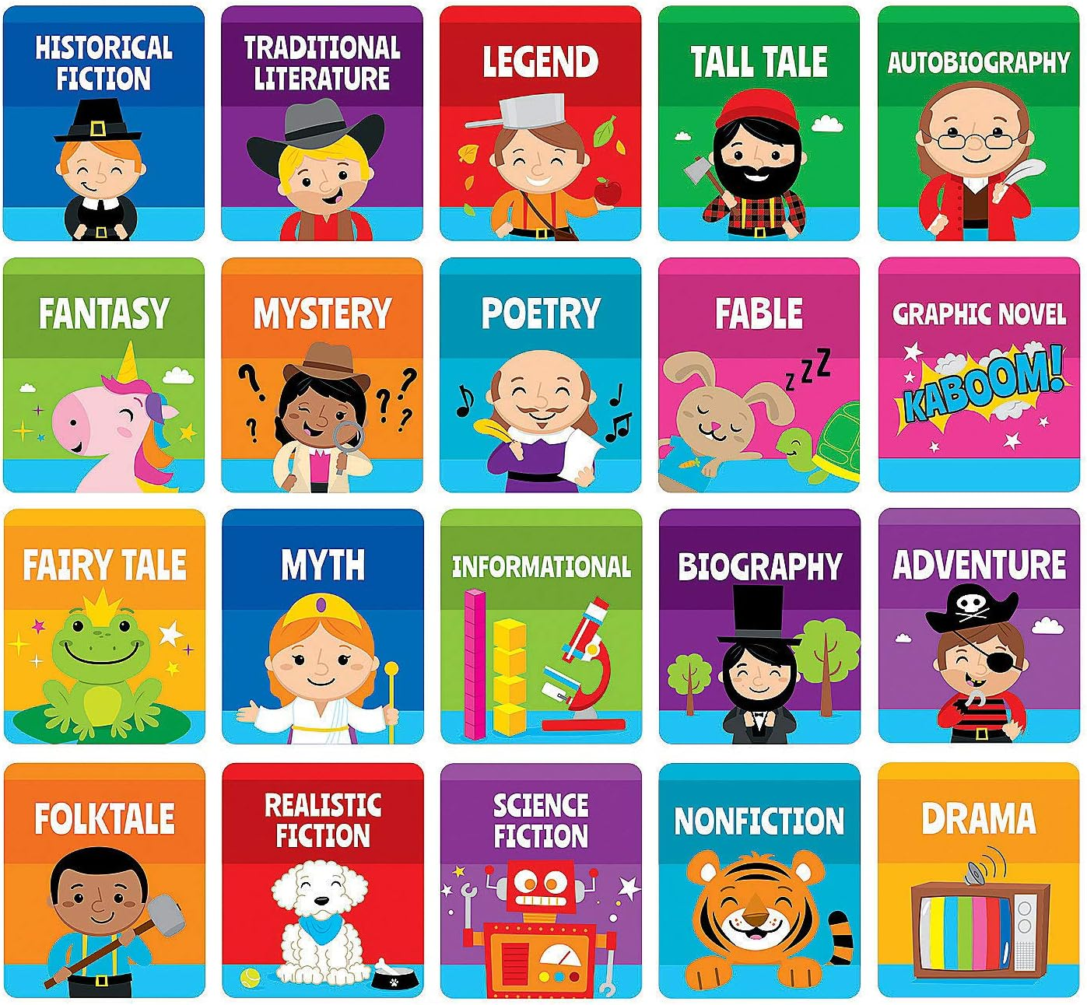
How can you support a ‘Love of Reading’?

Slide 20
How can you support a ‘Love of Reading’?
Visit libraries or book fairs together.
Include books in play spaces (e.g., baskets on the floor, colourful shelves).
Read signs in the street, menus, labels and instructions.
Incorporate technology positively
- Audiobooks and e-books can be brilliant, especially for reluctant readers.
Pair listening with physical books to build confidence.
Celebrate effort — not perfection.

Slide 21
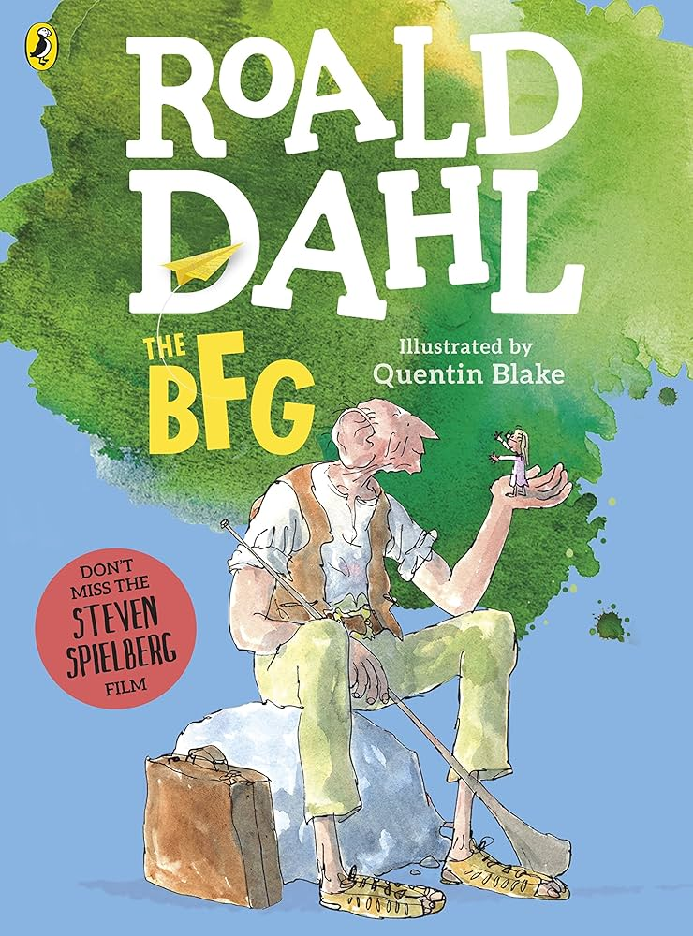
Getting Involved at Home
Here is the focus reading and writing text for year 3s this term.
The captivating plot, the humour and the unique vocabulary make this book very entertaining.
- Think about how you can get your child excited about this book.
What conversations can you have?
What questions can you ask?
How can you help your child to relate any one aspect of this story to real life situations, including making the right choices?

Slide 22

Any questions?

