Slide 1

The Parent Sessions:
Reading
Year 4

Slide 2
Welcome
“Think of a story you loved as a child — what made it special?”
Reading is about connection and conversation, not just decoding.

Slide 3

Goals
  Build children’s love of reading.
  Use talk to deepen understanding.
  Make reading together feel natural and enjoyable

Slide 4
Reading for Pleasure – Why It Matters
Let children choose books — comics, fact books, recipes all count.
Read little and often — 10 minutes a day makes a difference.
Model reading — talk about what you read.
Build simple rituals — bedtime reading, Saturday “story time,” library visits.

Slide 5

Asking one or two questions before, during, and after reading builds comprehension.
Before reading – spark curiosity:
  Nursery/Rec: “What do you think will happen?”
  KS1: “Who do you think this story is about?”
KS2: “What clues can you see about the plot?”
During reading – deepen understanding:
  Nursery/Rec: “How do they feel?”
  KS1: “Why do you think they did that?”
  KS2: “What might this tell us about the character?”
After reading – reflect and connect:
  Nursery/Rec: “What was your favourite part?”
  KS1: “What surprised you?”
  KS2: “What message do you think the author wanted us to learn?”

Slide 6
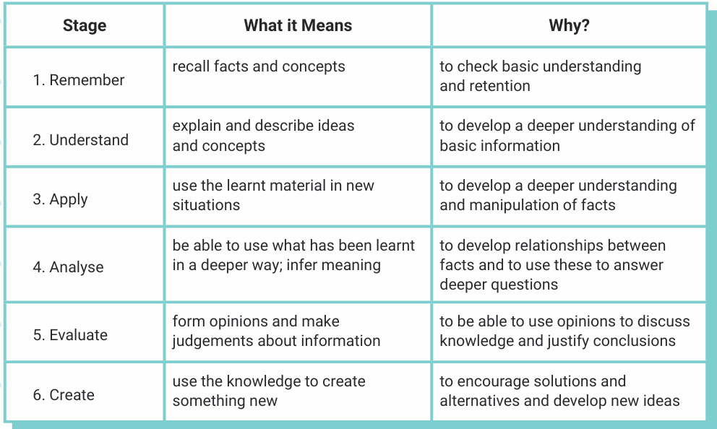
Reading Stages:

Slide 7
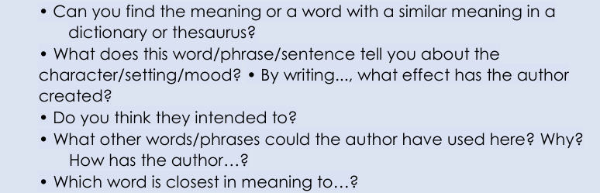
VIPERS - Vocabulary

Slide 8
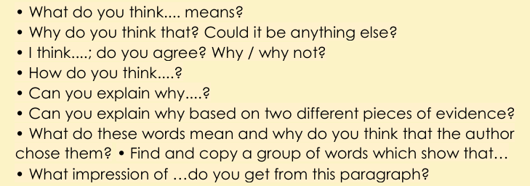
Inference

Slide 9
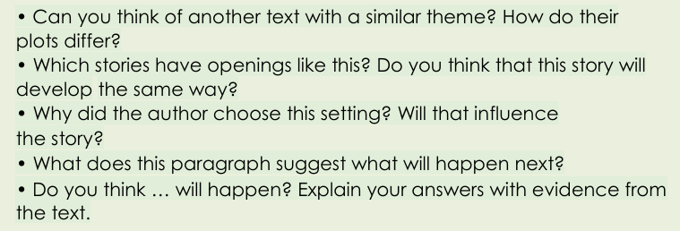
Prediction

Slide 10
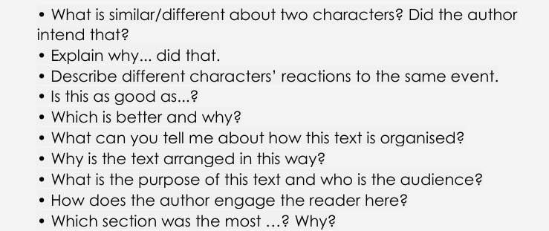
Explanation

Slide 11
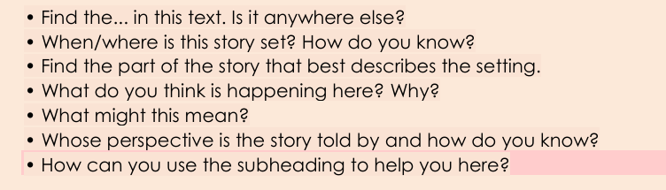
Retrieve

Slide 12
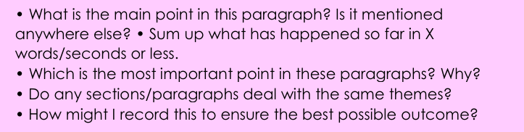
Summarise

Slide 13

Take-Home Tips & Q&A
A 10-minute bedtime read.
  Letting your child pick the book.
  Asking one “I wonder…” question each time they read.
Reading record books – why are they important?
ThePhoto by PhotoAuthor is licensed under CCYYSA.

Slide 14
Any questions?
Set a regular reading time: e.g., right after school, before bed, or weekend morning.
Create a comfortable reading space: good lighting, minimal distractions.
Show your child that you value reading – model it (reading your own book/newspaper).
Make reading at home a positive, relaxed time – not just another task.
Encourage your child to pick books they enjoy, as well as slightly challenging ones.

