Slide 1


Welcome to Year 1‘s
Reading Workshop
Helping children to build a love for reading.

Slide 2





Introduction
Reading is one of the most powerful ways to connect with your child.
Reading isn’t just about words — it’s about laughter, imagination, and time together.
Reading should feel like an adventure — full of laughter, imagination, and togetherness.
This afternoon, we’ll share simple ways to make reading feel joyful, natural, and fun.

Slide 3


Why Reading for Pleasure Matters!
When children enjoy reading, they:
  Build stronger vocabulary, creativity, and imagination
  Develop empathy and emotional understanding
  Concentrate better and become more independent learners
Reading for pleasure means children choose to read because they want to, not because they have to.
It’s about enjoyment and curiosity — not levels or tests.
For example:
Even a short bedtime story or a funny comic counts. Reading anything that sparks interest helps build lifelong habits

Slide 4


What is the purpose of today’s session?
During
Our 45-minute together:
  Welcome & Purpose – Why reading matters so much.
  Reading for Pleasure – Building daily habits at home.
  Modelling Reading Aloud – How simple talk deepens understanding.
  Parent Practice – Try out questioning strategies.
  Take-home Tips & Reading Records – Keeping reading fun at home.
This session is practical and relaxed — share your own ideas and questions as we go

Slide 5


Our Goal for Today
We want every child to:
  Feel confident and excited about reading.
  Enjoy stories that make them think, laugh, and wonder.
  Build daily reading habits that last a lifetime.
For parents:
Find small, simple ways to support your child’s reading at home — even 10 minutes a day makes a difference.
Reflection question:
How do you want your child to feel when they pick up a book? Happy? Curious? Proud?

Slide 6

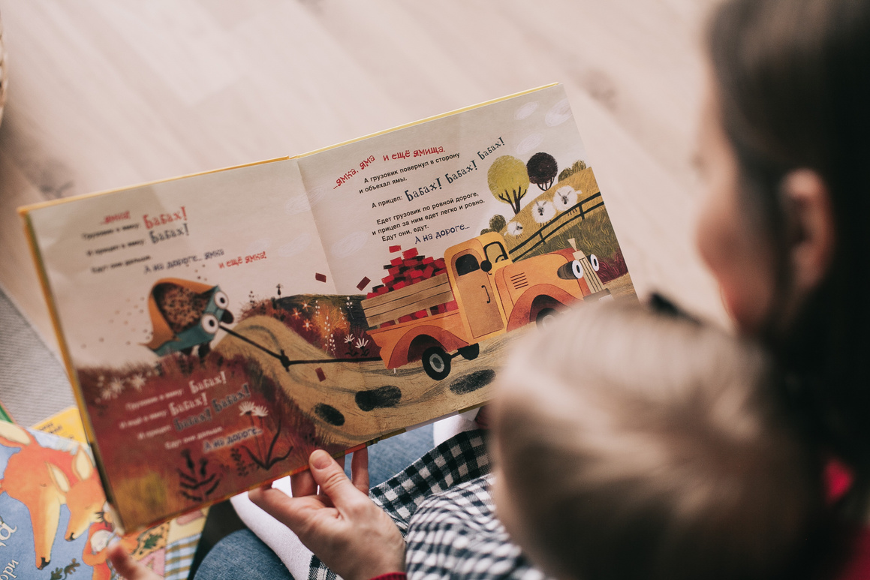
Reading for Pleasure: Simple Habits That Work
You don’t need lots of time or expensive books to build reading joy.
Here are five small habits that make a big difference:
  Let children choose — even if it’s the same book again.
  Read little and often — 10 minutes daily builds a routine.
  Model reading — let them see you enjoy books too.
  Talk about what you’re reading — share your favourite parts
  Make reading accessible — encourage your children to read everywhere they go: street names, bus signs, billboards, or even free newspapers on the bus.

Slide 7

Parent Practice: Questions in Action
Try this simple structure when reading at home:
  Before: “What do you notice about the cover?”
  During: “How do you think the character feels right now?”
  After: “Would you like to read more about them?”
If your child says, “I don’t know,” try:
  “Let’s look at the picture for a clue.”
  “What do you think might happen next?”
The goal is not to test, but to start a conversation.

Slide 8


Discovering Vocabulary Together
Reading is a wonderful way to explore new words and sentence patterns. Encourage your child to listen carefully for interesting vocabulary while you read together.
Try asking:
  “Did you hear any describing words (adjectives) in that sentence?”
  “What word told us how the character was feeling?”
  “Did you notice any joining words (conjunctions) that connect ideas?”
  “Can you find a word that means the same as…?”
Tips for parents:
  Celebrate when your child spots new or tricky words.
  Keep a “Word Wall” or small notebook for exciting new words.
  Use those new words in everyday talk — it helps vocabulary stick.

Slide 9
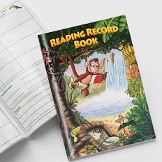
Reading Records: Connecting Home and School
Reading records help us work together to support your child’s reading journey.
In your child’s reading record, please jot:
  A quick comment on how they found the book (“easy”, “tricky”, “loved it”)
  Any favourites or topics they’re enjoying
  Requests for easier or more challenging books
Example of a comment:
“Loved the pictures but struggled with some new words. Could we try something slightly easier?”
These notes help us tailor book choices to your child’s needs and interests.

Slide 10

Promoting Fluency & Confidence
Fluency means reading smoothly, with understanding and expression.
To support fluency at home:
  Reread favourite books — repetition builds confidence
  Echo read: you read a line, then your child copies
  Encourage storytelling in their own words
  Celebrate effort, not perfection
Example phrase:
“I loved how you read that part with emotion.”
Confidence grows when children feel proud of their progress

Slide 11
Reading in Everyday Environments
Reading doesn’t just happen in books — it’s all around us. Make reading a part of daily life by encouraging your child to spot and read words wherever you go.
Ideas for everyday reading:
  Street names, bus numbers, and shop signs
  Food labels or menus at restaurants
  Instructions, leaflets, or posters in public spaces
  Free newspapers or bus adverts
Why it helps:
  These moments show children that reading has a real purpose and is useful everywhere.
  It builds confidence and curiosity — even a short trip can become a reading adventure.

Slide 12






Talk for Writing: Building Storytelling Skills
Before children can write confidently, they need to say and hear stories. Talk for Writing helps them learn patterns, structure, and rich language through speaking first.
How parents can support:
  Ask your child to retell a story in their own words.
  Use sentence starters like:
    “Once upon a time…”
    “One day…”
    “Then something surprising happened…”
  Encourage them to change the story ending or add a new character.
  Act out stories together using toys or props.
Why it works:
Talking builds memory, vocabulary, and imagination.
Children who can tell a story aloud can later write one with confidence.

Slide 13
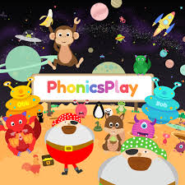



Here are safe, free sites to explore books online:
  Oxford Owl eBook Library – levelled reading books.
  Storyline Online – celebrities reading picture books aloud.
  BookTrust HomeTime – games, videos, and read-alongs.
  BBC Bitesize Reading – fun literacy activities.
  World Book Day – Share a Story Corner – video stories and crafts.
Let your child pick what interests them most — choice encourages motivation.
Free Online Reading Resources

Slide 14
Take-Home Tips & Final Thoughts
Read little and often — 10 minutes a day works wonders
  Let your child choose what to read
  Talk, wonder, and laugh about stories together
  Record small successes in their reading record
  Celebrate every effort — progress over perfection
Sample questions to ask at home:
  “I wonder what will happen next?”
  “What was the funniest part?”
  “Would you like to find another book like this one?”
Thank you for coming! Together, we can help every child discover the joy of stories.

