Slide 1
Reading Workshop
Year 2

Slide 2
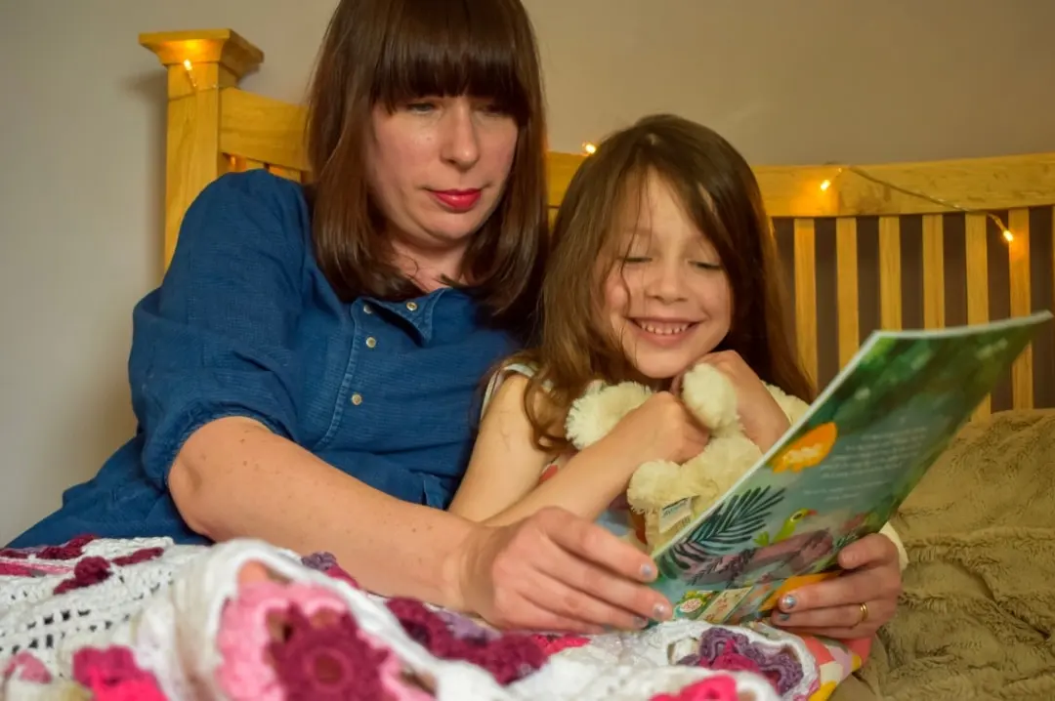
Welcome to Our Year 2 Reading Workshop
“Reading is joy, not a test.”
Today we’ll explore how reading together can spark curiosity, connection, and confidence.
Aim: To build children’s love of reading and show families how to support understanding through talk.
Notes:
Greet everyone warmly. Invite parents and children to think: “What was your favourite story as a child? Why did you love it?”
Mention that reading is about conversation and connection, not just decoding words.

Slide 3

Why Reading for Pleasure Matters
Builds imagination and vocabulary
Strengthens family bonds
Supports learning across all subjects
10 minutes a day can make a huge difference!
Share a quick story or example from your class — “When we read ___, children were buzzing with ideas!”
Emphasize that any reading counts — comics, recipes, fact books, football magazines.

Slide 4







Easy Ways to Build Reading Habits
Let your child choose what to read
Read little and often
Talk about books — ask “I wonder…” questions
Make it part of your routine: bedtime, Saturday mornings, library trips
Notes:
Show 3–4 books of different types (picture book, short chapter, non-fiction, poetry).
• Mention your class’s current reading focus or favourite book.

Slide 5
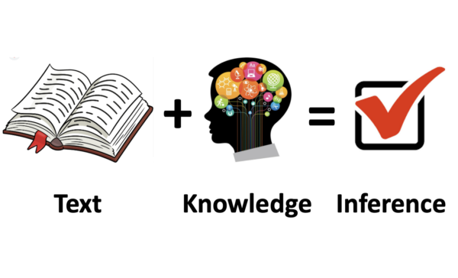
Reading Aloud – Bringing Stories to Life
Read once plainly, then again with expression
Talk before, during, and after reading
Use questions to deepen understanding
Example Prompts :
Before: “Who do you think this story is about?” -Prediction
During: “Why do you think they did that?”- Inference
After: “What surprised you the most?”- Opinion
Notes:
• Model with a short passage from a Year 2 favourite
• Highlight how tone and expression make reading fun and meaningful.

Slide 6
Parent Practice: Questions in Action
Instructions
In pairs (parent + child or two parents), choose a book or page.
Try one question before, one during, one after.
Share one question with the group.
Optional Challenge:
What if your child says, “I don’t know”?
→ Try “Let’s look again” or “What do you think might happen?”
Notes:
Circulate and support families.
Celebrate curiosity and all types of responses.

Slide 7
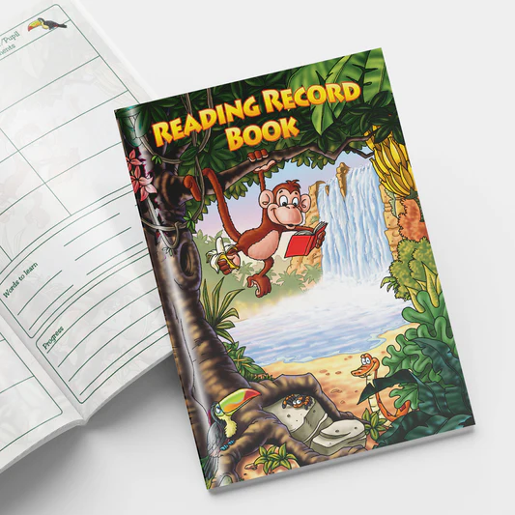
Reintroducing Our Reading Record Books
A tool for celebrating reading, not a chore!
Jot quick notes: favourite parts, new words, “I wonder…” moments
Share and celebrate reading at school
Notes:
Show a sample reading record (include an example entry).
Encourage families to make it their own — drawings, quotes, or stickers all count.

Slide 8
Take-Home Tips for Reading Together
✅ 10 minutes a day — little and often
✅ Let your child pick the book
✅ Ask one “I wonder…” question
✅ Talk about favourite moments
✅ Keep reading fun!
Notes:
Reinforce that it’s about connection, not perfection.
Encourage families to visit local libraries or swap books.

Slide 9
Thank You for Reading with Us!
“The more that you read, the more things you will know.” – Dr. Seuss
Questions or ideas to share?
Oxford Owl- https://www.oxfordowl.co.uk/
Busy things- https://www.busythings.co.uk/
Notes:
Invite informal chat or questions.
Mention where families can find recommended book lists or get more support.

