Slide 1

Building Lifelong Readers: A Parent’s Guide to Success
Year 6 – Reading workshop
2025-’26

Slide 2

Workshop Goals and Objectives
Understand the importance of reading at home
Address common challenges
Learn strategies to engage children
Explore effective communication
Share experiences and best practices

Slide 3
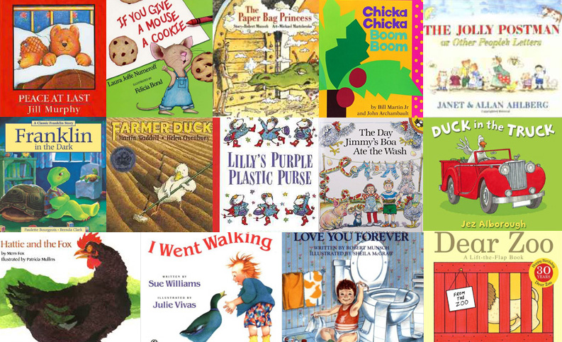
Reflection:
Think of a story you loved as a child — what made it special?​
Reading is about connection and conversation, not just decoding.​

Slide 4
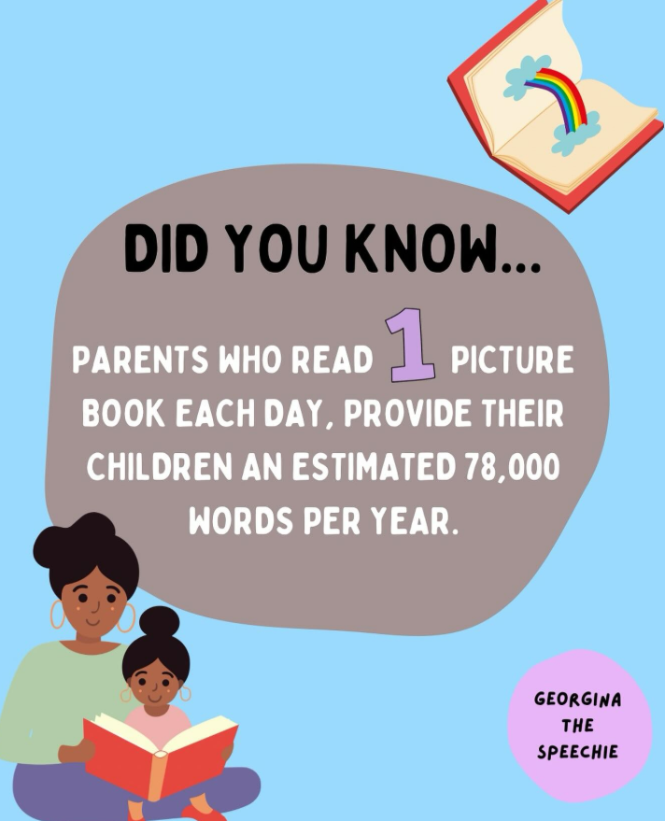
Why Reading Matters at Home
Builds vocabulary and comprehension.
Strengthens parent-child bonding.
Encourages lifelong learning habits.

Slide 5

Reading at home- Common Challenges
Limited time for reading
Children reluctant to read
Choosing age-appropriate books
Distractions at home
Parents unsure how to help
Language barriers
Limited access to books
Pressure and frustration
Different reading levels among siblings
Maintaining motivation over time

Slide 6
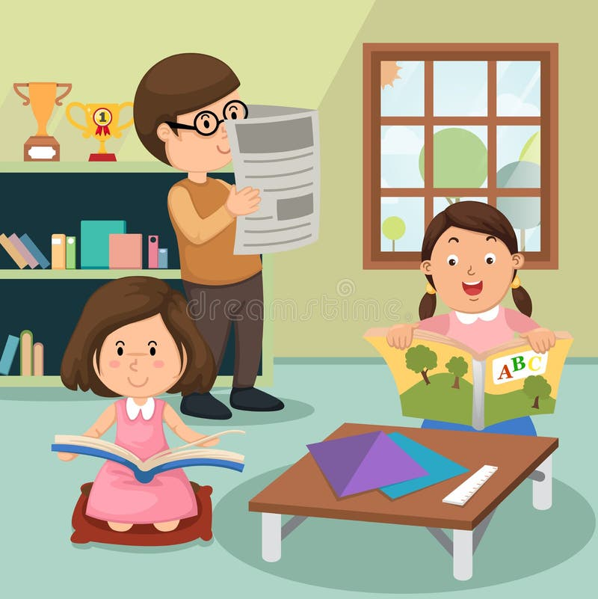
Strategies to Engage Children
Create a Reading Nook
Set up a cozy space with cushions and books to make reading a more inviting experience.
Choice and Ownership
Let children choose what they read—comics, magazines, or novels—to build interest.
Family Reading Time
Schedule 10–15 minutes where everyone reads together (modeling matters!)..
Connect Reading to Interests
If a child loves dinosaurs, find books or articles about them.
Celebrate Reading Achievements
Create a “Reading Star Chart” and reward milestones.
Make It Interactive
Act out scenes, draw characters, or create a mini-book review video.

Slide 7

Reading at home - Effective Communication Ideas
Praise Effort and Curiosity
Focus on engagement rather than speed or accuracy.
Use ‘Think Aloud’ Strategy
Model your own thinking: “I wonder why the author used that word…”
Summarize Together
After reading, ask: “Can you tell me the main idea in your own words?”
Ask Open-Ended Questions
“What do you think will happen next?”
“Why do you think the character made that choice?”
Encourage Predictions and Inferences
Before turning the page, ask: “What clues tell you what might happen?”
Relate to Real Life
“Has anything like this ever happened to you?”

Slide 8
Task 1-Book Talk Carousel
Parents rotate in small groups sharing their child’s favorite book and why.
Collect ideas for diverse reading choices.

Slide 9
Task 2 -Create a Reading Routine Plan
Parents design a simple daily reading schedule for home.
Share ideas for making it fun (e.g., reading corners, themed nights).

Slide 10
Task 3 - Post-it Reflection Wall
Parents write one new strategy they will try at home and stick it on a “Commitment Wall.”

Slide 11

Any questions???
“Reading is the gateway to imagination and understanding. When children read every day, they build vocabulary, strengthen comprehension, and develop a lifelong love of learning. Your support at home makes all the difference—read together, talk about stories, and celebrate every page turned!”

Slide 12

Thank you!

