Slide 1
EYFS Reading Workshop

Slide 2

Welcome
In the Early Years, reading is about connection, talk, and joy — not just learning letters or words.
Children learn best when they feel relaxed, engaged, and curious.
🎯 Our Goals Today
❤️ Help children fall in love with stories and books
🗣️ Use talk and play to build early language and understanding
🤗 Make reading together feel natural, warm, and enjoyable at home
📚 Understand how everyday routines — bedtime, shopping, playtime — can include story moments

Slide 3
EYFS Connection
Reading for pleasure supports key EYFS areas:
Communication & Language – talking about stories and pictures
Personal, Social & Emotional Development – sharing time and empathy
Literacy – developing early love of books and print awareness

Slide 4

Reading for Pleasure – Why It Matters
In EYFS, reading for pleasure helps children:
  🗣️ Develop language and communication skills
  ❤️ Build strong relationships through shared moments
  🌈 Grow imagination and curiosity
  💭 Begin to understand feelings and ideas in stories
  “Children learn to love reading when it feels joyful, not like a task.”

Slide 5
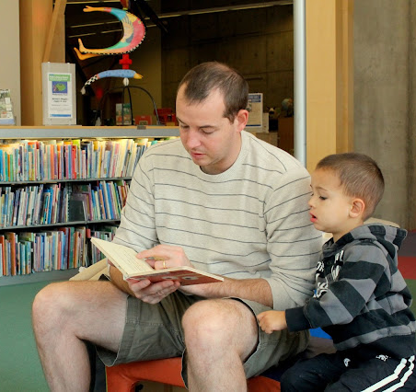
How Can Parents Help?
Let children choose – picture books, comics, recipes, fact books — they all count!
➜ Children are more motivated when they feel in control.
Read little and often – just 10 minutes a day makes a real difference.
➜ Short, regular story times build routine and comfort.
Model reading – let your child see you reading too (shopping list, text, recipe).
➜ Children copy what adults do — it shows reading is part of life.
Build simple rituals – bedtime story, Saturday “story time,” or a weekly library visit.
➜ Consistent routines help children look forward to reading moments.

Slide 6
Modelling: Reading Aloud & Talking About Books
Before reading – spark curiosity: “What do you think will happen?”
During reading – deepen understanding: “How do they feel?”
After reading – reflect and connect: : “What was your favourite part?
Notes:
Emphasize that reading is not just about words—it's about talking, imagining, and connecting.

Slide 7

Before Reading – Spark Curiosity
Purpose: To build interest and prediction skills.
Model questions:
“What do you think this story might be about?”
“Look at the cover — who do you think this character is?”
“Where do you think the story takes place?”
“What do you think might happen to the mouse?”

Slide 8
During Reading – Deepen
Understanding
Model questions:
“How do you think the mouse feels right now?”
“What do you think the Gruffalo will do next?”
“Why do you think the fox ran away?”
“Can you find something in the picture that tells us how the character feels?”

Slide 9
After Reading – Reflect and Connect
Purpose: To strengthen memory, emotional connection, and conversation skills.
Model questions:
“What was your favourite part of the story?”
“Was there anything that surprised you?”
“Which character would you like to be, and why?”
“Does this story remind you of something you’ve done or seen?”
Notes:
(Encourage parents to praise their child’s ideas and make personal connections.)

Slide 10

Reflect Now.
“Which questions do you think your child would enjoy most?”
“How do you usually share books at home?”
“What might you try differently after today?”

Slide 11
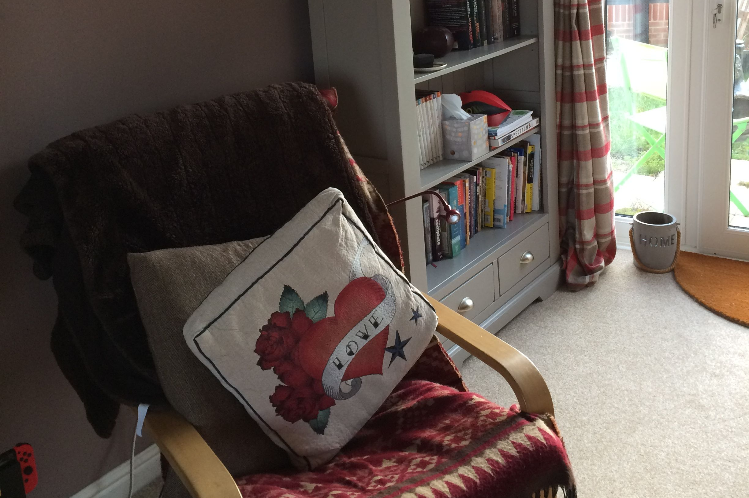
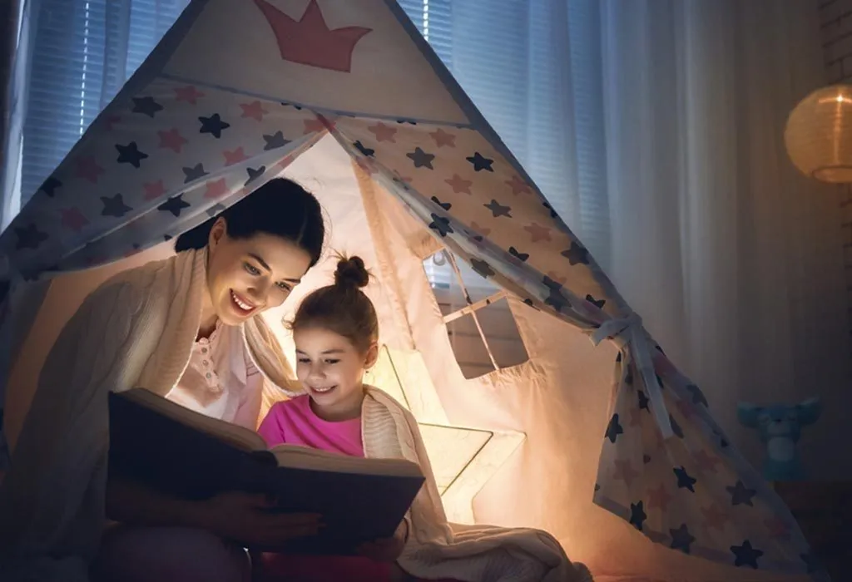
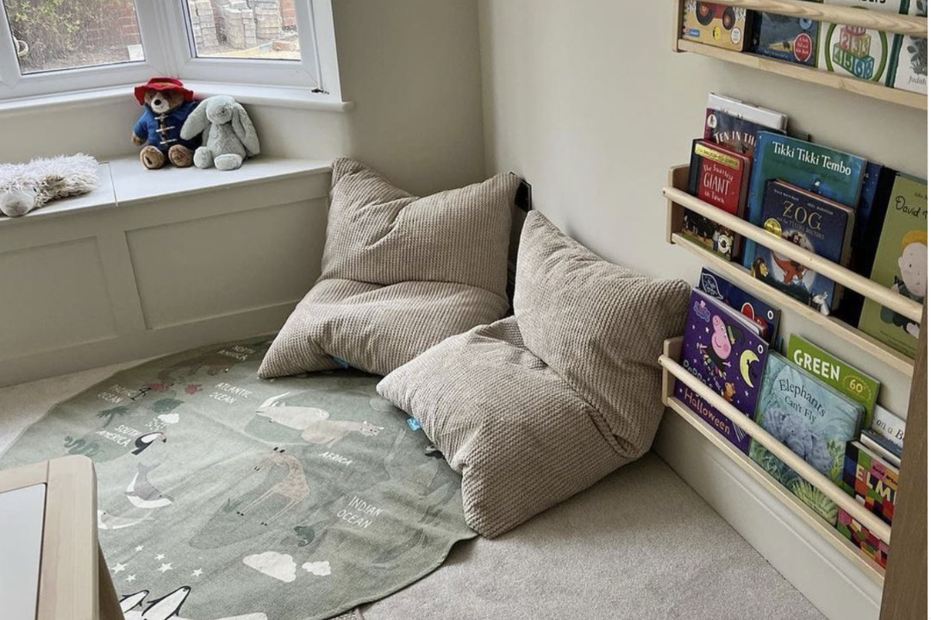
Simple ways to make a cosy at-home reading corner.
🏡 Find a quiet spot – Choose a calm corner with good light where your child can relax and focus.
🛋️ Add comfy seating – Use cushions, a blanket, or a bean bag to make it soft and inviting.
📚 Keep books within reach – Use a basket or low shelf so your child can choose their own books.
✨ Create a warm atmosphere – Add fairy lights or a small lamp and keep the space calm and clutter-free.
🧸 Include personal touches – Add a teddy “reading buddy,” your child’s name, or a favourite poster to make it special.

Slide 12
Take-Home Tips
Read together every day – even just for 5–10 minutes.
Talk about pictures as much as words.
Praise curiosity and imagination, not just correct answers.
Revisit favourite books – children love repetition!

Slide 13
Recommended book list for EYFS readers (ages 3–5)
📚 Classic & Well-Loved Stories
The Very Hungry Caterpillar – Eric Carle
Brown Bear, Brown Bear, What Do You See? – Bill Martin Jr. & Eric Carle
We’re Going on a Bear Hunt – Michael Rosen
Dear Zoo – Rod Campbell
The Gruffalo – Julia Donaldson & Axel Scheffler
Room on the Broom – Julia Donaldson & Axel Scheffler
Each Peach Pear Plum – Allan & Janet Ahlberg
Peace at Last – Jill Murphy
Can’t You Sleep, Little Bear? – Martin Waddell
Guess How Much I Love You – Sam McBratney
❤️ Books About Feelings & Friendship
The Colour Monster – Anna Llenas
Ruby’s Worry – Tom Percival
The Invisible String – Patrice Karst
Giraffes Can’t Dance – Giles Andreae
Lost and Found – Oliver Jeffers
Stick Man – Julia Donaldson & Axel Scheffler
While We Can’t Hug – Eoin McLaughlin
The Smartest Giant in Town – Julia Donaldson
I’m Sticking with You – Smriti Halls & Steve Small
The Lion Inside – Rachel Bright & Jim Field
🌟 Stories that Spark Imagination
Not Now, Bernard – David McKee
Whatever Next! – Jill Murphy
Shark in the Park – Nick Sharratt
Oi Frog! – Kes Gray & Jim Field
How to Catch a Star – Oliver Jeffers
The Way Back Home – Oliver Jeffers
The Rainbow Fish – Marcus Pfister
Elmer – David McKee
Supertato – Sue Hendra & Paul Linnet
Aliens Love Underpants – Claire Freedman & Ben Cort
🧠 Early Learning & Rhyme
Ten Little Fingers and Ten Little Toes – Mem Fox & Helen Oxenbury
Handa’s Surprise – Eileen Browne
The Train Ride – June Crebbin
One Mole Digging a Hole – Julia Donaldson
Wow! Said the Owl – Tim Hopgood
A Squash and a Squeeze – Julia Donaldson & Axel Scheffler
Lulu Loves the Library – Anna McQuinn
Maisy’s Bus – Lucy Cousins
Hair Love – Matthew A. Cherry
My Mum / My Dad – Anthony Browne

